Slide 1

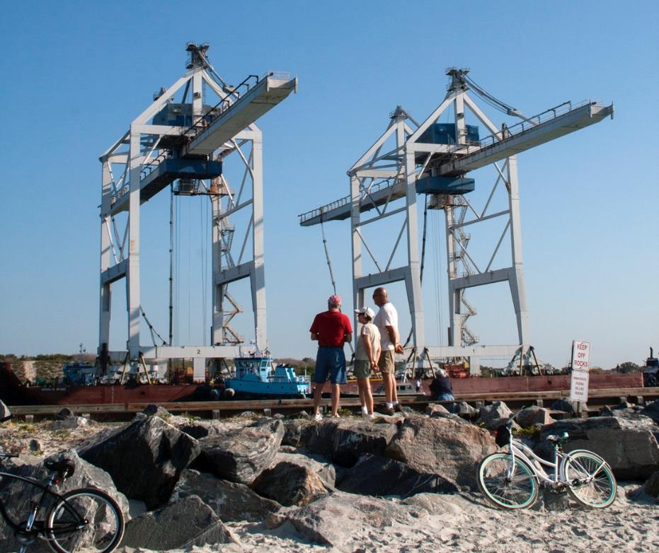
Arrival
Port
Canaveral
Cargo Cranes
Special Events (12)
Use this area for logo
(delete text box before placing logo)

